Slide 1
Cisco Rapid Iteration for NetOps and Devops Engineers
Updated May 2023
RAD SDLC Lab
Sherri Conrod
Solutions Architect, Global Partner Organization
February 2022

Slide 2
Way of Working
RAD SDLC Work-Flow Model for Lab for SD-WAN Automation for MSPs – LTRAPP-3000
Each Participant will be actively working in the lab from the start, which means they will be typing on their keyboard to edit code, push their code to a repo, and watch their code build in the pipeline as well as logging onto SD-WAN Consoles to view the results of their automation
Each Participant will:
be assigned an AZ by the Instructor and a git branch. The Instructor will add each participant to the git org, and the Participant will receive an email invitation they will accept. Students must already have a 4096 bit RSA Key associated with their github account
If the Participant does not have a git account, the Instructor will give you a temporary git account and ssh-key to use to push your code
Start the Lab by cloning the lab repo and checking out a branch from the current release branch
Clone the lap repo and checkout their branch. Update their vars file after receiving instructions then do a git add, commit, and push to their branch –this will ready their CI Pipeline to deploy their cloud lab environment
The Participant will be provided a login to the CI Tool: http://prod-ci.devops-ontap.com:8080
The Participant will logon to the CI Tool and select to deploy their lab environment to the Cloud
Once deployed, the Participant will set up the SSH keys generated during the lab setup to verify they can SSH to their cloud instances and then logon to the SD-WAN gui to complete the configuration steps that are decoupled from the API and CLI.

Slide 3
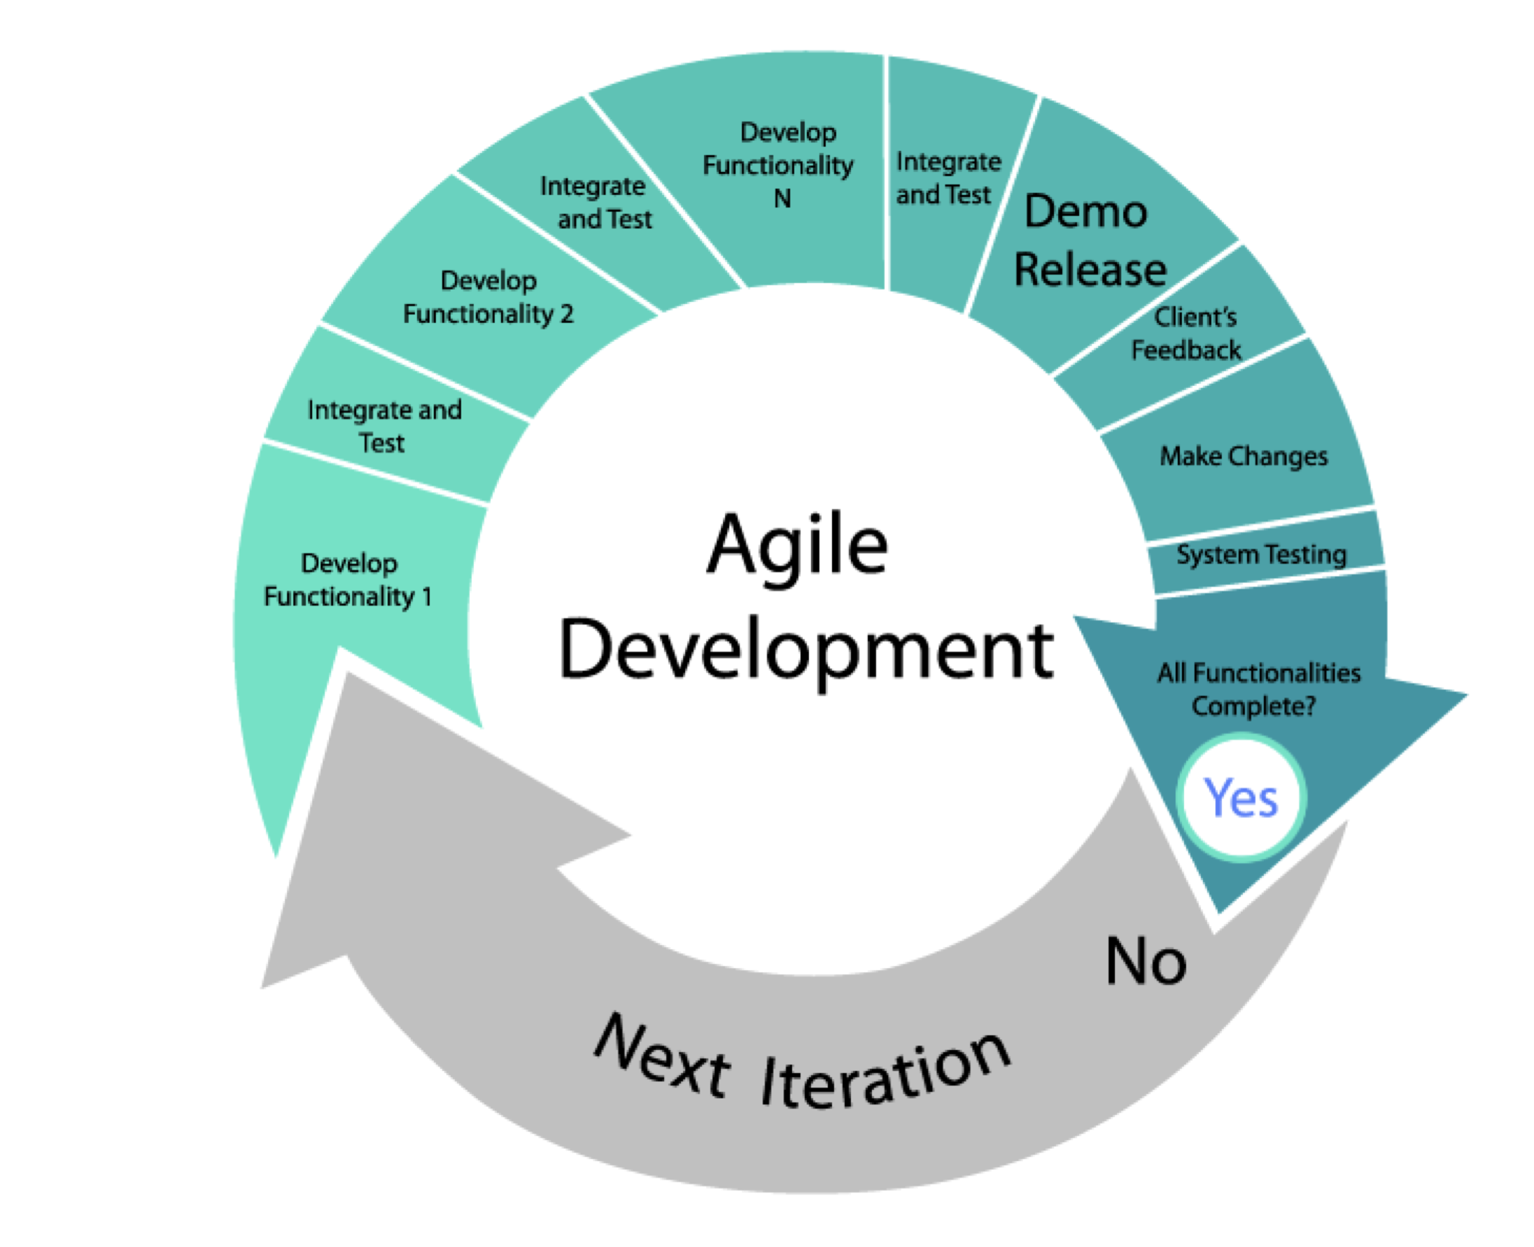




RAD SDLC Workflow
Fill this with a relevant photo, illustration, graph, etc.
Git – All Changes in Git
Pipeline Builds Env and Config from Git Branch
Pipeline Builds Environment and Configurtions via Git using Docker based Build Containers
Pipeline Build Containers do the work of Communicating with Vault, AWS, Docker, Git to deploy the Env to AWS from Code
Students update git only to kick off pipeline to make config changes to lab environment

Slide 4
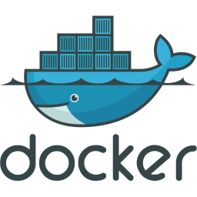



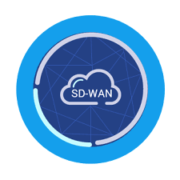
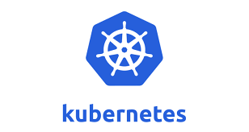


RAD SDLC Work-flow
Netops/Devops
GUI Users (Application Users)

Slide 5
Benefits
Single single sign-On to all Cisco any and all other OS and Applications
Technology used as wedge to make people work differently – using agile rapid iteration. Developing small ’chunks’ or tasks of code across developers and teams and testing the code immediately
Open source and highly performant and inexpensive. Ephemeral build containers are garbage collected immediately and use only the minimal resources required.
Solution is non-opinionated and close to primitives making it highly flexible and quick to adopt. Uses any OS and any code languages. Uses OCI compliant build containers
Operators do not need to learn any opinionated tools like HCL(Terraform), Groovy(Jenkins) etc.
No dependencies on plugins(Jenkins) or providers(Terraform)
Easy to administer and scale as it runs on Kubernetes and stable helm charts available
Integrates with all common single sign on solutions –
Allows for secure antifactory of variables, config files

Slide 6
SD-WAN Multi-tenancy cluster automated – Day 0,1,2 and ½ Day 3
Manual steps which may be automated via API in next release
Reset GUI password on all vmanage instances
Change to multi-tenancy node on first vmanage instance and reboot
Set the cluster ip on the first vmanage node and reboot
Add in each vmanage cluster ip to primary node GUI in the cluster administration pane and reboot.
Each reboot can take between 10-20 minutes, therefore, it does not make sense to try to perform these steps programmatically because, even when polling the services on the machines, the API frequently does not respond until many minutes after the nms application services and web services are responding.
At a later date, automation of these steps will be attempted using service monitoring and an API webhook, however for now they are manual.

Slide 7
Enterprise CA
MSPs will all have an Enterprise CA and as such will need to generate a root-ca.pem, and process the CSRs for all nodes in the cluster.
To test out this process, you can install the root-ca on the 1rst vmanage node. Follow the steps in the devops-ontap/sdwan/enterprise-cert-steps.md. Remember to install the CA chain on all instances as well as Edge Devices.
Portions of this process may be handled via API however, are incredibly complex and it may be easier to do this manually to start to understand the process.
Note: the process for edges is different from vmanage, vbond, and vsmart.

Slide 8
Edge Devices, Licenses and Certificates
For Edge devices, follow the steps to ensure you have imported the license file to the Tenant first, and then have registered the OTP and virtual serial of a device in the license file via the command line from the device.
You will need to track usage in a spread sheet externally to know which licenses for virtual devices have been allocated.
Install the CA Chain on the Edge Device
AFTER, registering the OTP and serial number listed for one virtual device of same type as displayed in the Tenant’s device list, you may then request a CSR for the edge device.
Install the cert and verify the device shows as having an installed valid certificate

